Slide 1
Women Safety Online
A Capstone Project with Polytechnic University of Valencia

Slide 2
Introduction
Problem Statement
Objective
Work plan
Q & A

Slide 3
Introduction
The Oxford English Dictionary defines sexism as prejudice, stereotyping or discrimination, typically against women, based on sex
Sexism is commonly found in many forms in social networks, and it encompasses a wide range of behaviors (such as stereotyping, ideological issues, sexual violence, etc.
According to a previous survey conducted during summer internship:
The biggest threats online are in texts chats and unwanted pictures
The most unsafe platforms are Instagram and chat apps like WhatsApp

Slide 4
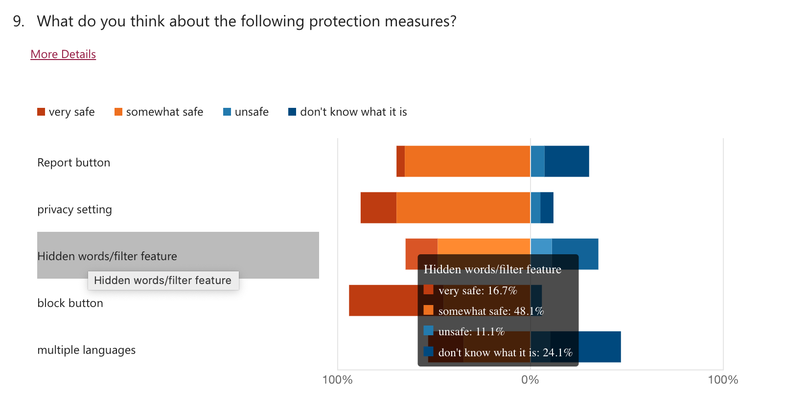
Results of Survey: hide / filter words
16% + 48% = 64% think hide word feature is very useful

Slide 5
Problem Statement

Slide 6

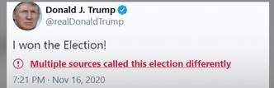
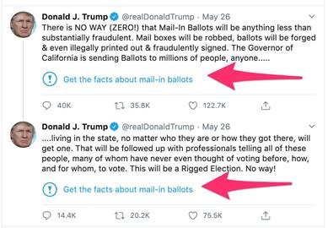
Problem Statement
Social Media platforms have hide sensitive contents (image / video)
Hiding sensitive text feature is supported only for hate speech and fake news on social media, but sexism contents identification are not supported.
Sexism detection it is a challenging tasks
So many linguistic challenges
So many languages
….

Slide 7
Objective
Build a model to automatedly flag sexist text content and explain why

Slide 8

Align with SDGs

Slide 9

Mapping with indicators
5.2- By 2030, eliminate all forms of violence against all women and girls in the public and private spheres, including trafficking and sexual and other types of exploitation.
5.b - By 2030, enhance the use of enabling technology, in particular information and communications technology, to promote the empowerment of women.

Slide 10
Machine Learning model
Train a model from scratch or fine-tune a pretrained model
Data sources
Use SemEval 2023 shared task dataset CodaLab - Competition (upsaclay.fr)
ManRo/Sexism_Twitter_MeTwo · Datasets at Hugging Face
Pre-trained models
https://huggingface.co/models?sort=downloads&search=sexism
Students are free to choose other data sources or models

Slide 11
Work Plan

Slide 12
Project Advisors
Name | Role | Contact
Jose Hernández Orallo | Faculty advisor | jorallo@upv.es
Anusha Dandapani | UNICC Capstone lead | dandapani@unicc.org
Lizzette Soria | Subject Matter Expert (SME) | lizzette.soria@unwomen.org
Elena Tejadillos | UNICC Data Focal Point | tejadillos@unicc.org
Motaz Saad | UNICC Data Focal Point | saad@unicc.org
Ana Ribeiro | UNICC Data Focal Point | ribeiro@unicc.org
Anna Llinares | UNICC Data Focal Point | llinares@unicc.org

Slide 13
Project timeline
24/02/2023
Introduction to Capstone Project
March 2023
Technical Clarification by UNICC data team
March 2023
Process meetings
April 2023
Q & A meetings
May 2023
Final Presentation
April 2023
Review Meeting

Slide 14
Project timeline
Date | Session | UNICC Members | Duration
24/02/2023 | Introduction to the capstone project | Data Experts | 1 Hour
March 2023 | Technical Clarification Biweekly meetings | Data Experts | 1 Hour
April 2023 | Q&A Sessions | Data Experts | 1 Hour
May 2023 | Final Presentation to UNICC | UNICC Team (Data & Academic leads) | 1 Hour

Slide 15
Data
Git Hub Repositories link and access UNICC GitHub
Prepare & Clean data
Data Definitions documented
Meta Data updated
Agree on data principles and guidelines to follow

Slide 16
Project Outcomes
Python notebooks & Final presentation uploaded to UNICC GitHub
Reusable Python classes and modules
Project documentation (method, code documentation, deployment, ….)
UNICC <> UPV write up on outcomes to be published in UNICC website
Final presentation with UNICC team
Complete UNICC survey

